Slide 1

DATA ENGINEERING 2
CHAPTER 2/3/4
Laszlo Sallo
OCTOBER 2020

Slide 2

THE ELEPHANT IN THE ROOM
HOW TO HANDLE
LARGE
UNSTRUCTURED
DATA?
Notes:
WHAT MAKES UNSTRUCTURED HARD?

Slide 3
UNSTRUCTURED DATA
YOU CANNOT CREATE AN EFFICIENT INDEX ON UNSTRUCTURED DATA
YOU NEED TO SCAN YOUR DATA WHEN YOU ARE SEARCHING

Slide 4

READ/WRITE EFFORT
SMALL
STRUCTURED DATA
LARGE
UNSTRUCTURED DATA
W
CREATE INDEX
WRITE DATA
WRITE DATA
R
RETURN
DATA
SCAN DATA
RETURN
DATA
DISTRIBUTE!

Slide 5
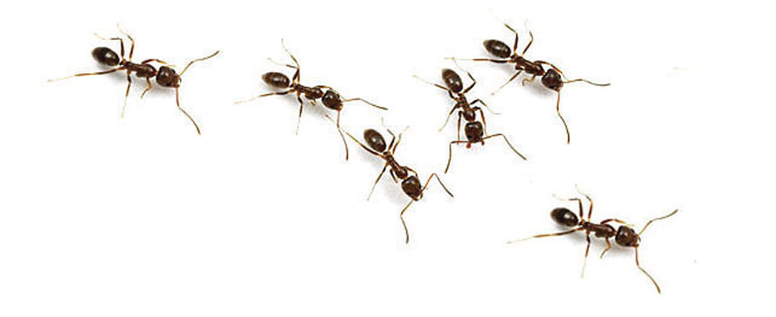
DATA LAKES
OPERATIONS
PRODUCTION
DB
Data lake
(Raw Data)
Advanced DS
DB
Analytics
DB
Stream
Reporting

Slide 6
DATA WAREHOUSE VS DATA LAKE
 | DATA WAREHOUSE | DATA LAKE
Data form | Structured | Anything / Mainly unstructured
Stored data | Relevant data | Raw data
Volume | Large | Ultra large
Users | Analysts | Analysts
Data quality | High control | Low control
Price | High upfront cost | Lower pay-as-you-go cost
Hardware | Large servers | Commodity
Implementation time | Months | Hours

Slide 7

NOSQL

Slide 8
INTEGRITY AND CONSISTENCY
BASICALLY AVAILABLE
SOFT STATE
EVENTUAL CONSISTENCY
BASE
NO ACID
TRANSACTION IS
NOT HANDLED BY DB

Slide 9
INTERFACE
SQL
ActionScript Bash C C# C++ Clojure Common Lisp Crystal D Dart Delphi Elixir emacs lisp Erlang Fancy gawk GNU Prolog Go Haskell Haxe Io Java Julia Lasso Lua Matlab mruby Nim Node.js Objective-C OCaml Pascal Perl PHP PL/SQL Pure Data Python R Racket Rebol Ruby Rust Scala Scheme Smalltalk Swift Tcl VB VCL Xojo …

Slide 10

SCHEMALESS OR SCHEMA FREE
A SMART DATABASE CAN FIGURE OUT
THE DATATYPE
THE STRUCTURE

Slide 11

ALGORITHMS DEEP IN THE DATABASE
NO NEED TO MINE

Slide 12


MADE FOR CLOUD

Slide 13
NOSQL VARIETY
100s
OF NOSQL
SOLUTIONS
CLOUD BASED
TIME SERIES DB WITH
TIME AGGREGATION FUNCTIONS
USING SQL
SCHEMA FREE JSON
DOCUMENT STORE
WITH TRANSACTION HANDLING
GRAPH DATABASE WITH GQL AND
NETWORK VISUALIZATION
1
2
3

Slide 14
NOSQL CLASSIFICATION
KEY-VALUE STORES
TIME SERIES DBMS
DOCUMENT STORES
COLUMN STORES
SEARCH ENGINES
GRAPH DBMS

Slide 15
DB-ENGINES.COM
YOUR ULTIMATE SOURCE TO
EXPLORE
http://db-engines.com/en/system/MySQL
http://db-engines.com/en/system/Elasticsearch
CATEGORIZE / KNOW THE TRENDS
http://db-engines.com/en/ranking_categories
http://db-engines.com/en/ranking_osvsc
http://db-engines.com/en/ranking_trend
COMPARE
http://db-engines.com/en/system/Elasticsearch%3BMongoDB

Slide 16
EXERCISE
CAN I INSTALL REDSHIFT ON MY LAPTOP ?
WHAT ARE THE TYPICAL APPLICATION SCENARIOS FOR CASSANDRA ?
CAN NEO4J PARTION DATA OVER MULTIPLE NODES ?

Slide 17
THE NEW TOOLS
NOSQL
SET OF SOLUTIONS
PERFORMANCE ORIENTED
DATABASE
OPERATIONAL AND ANALYTICAL
STRUCTURED/ SEMI-STRUCTURED
BIG DATA
SET OF SOLUTIONS
DATA VOLUME ORIENTED
DATA FRAMEWORK
ANALYTICAL
MAINLY UNSTRUCTURED

Slide 18
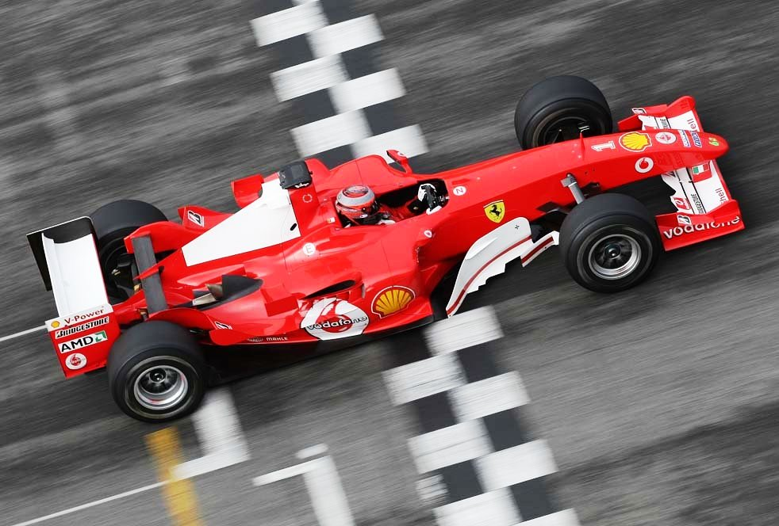
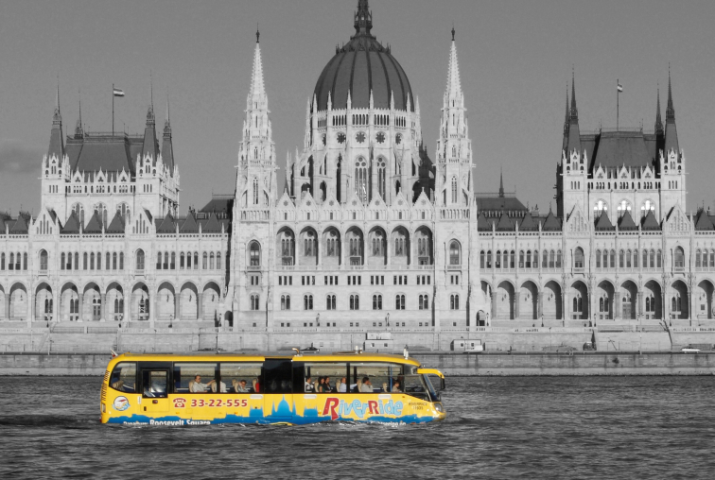
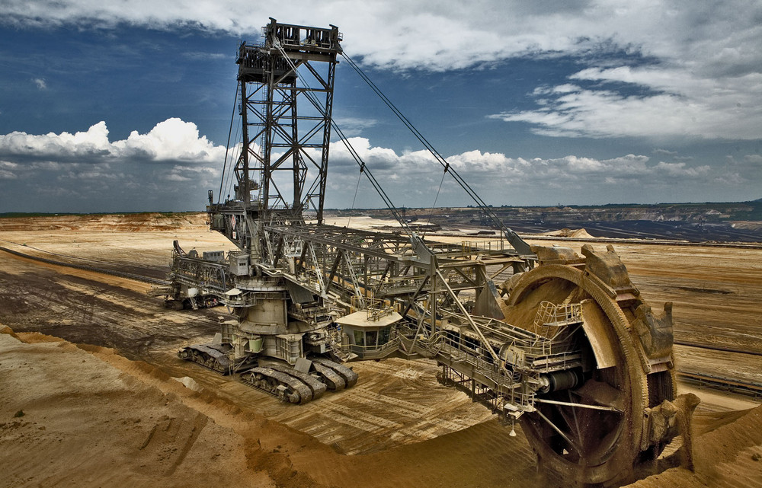
GAME
WHICH ONE YOU
WOULD ASSOCIATE
WITH
RDBMS,
NOSQL,
BIGDATA ?
1
2
3

Slide 19
NOSQL CLASSIFICATION
KEY-VALUE STORES
TIME SERIES DBMS
DOCUMENT STORES
COLUMN STORES
SEARCH ENGINES
GRAPH DBMS

Slide 20
KEY-VALUE DATA FORM - EXAMPLES
key | value
1 | John
2 | Mary
3 | Peter
key | value
War and Peace | ‘Well, Prince, so Genoa and Lucca are now just family …”
The Master and Margarita | “At the sunset hour of one warm spring day two men were to be seen …”
The Winter of Our Discontent | “I wonder how many people I've looked at all my life and never seen.”

Slide 21
KEY-VALUE STORE FEATURES
SIMPLEST DBMS VARIANT
EASY TO SCALE
HIGH PERFORMANCE

Slide 22
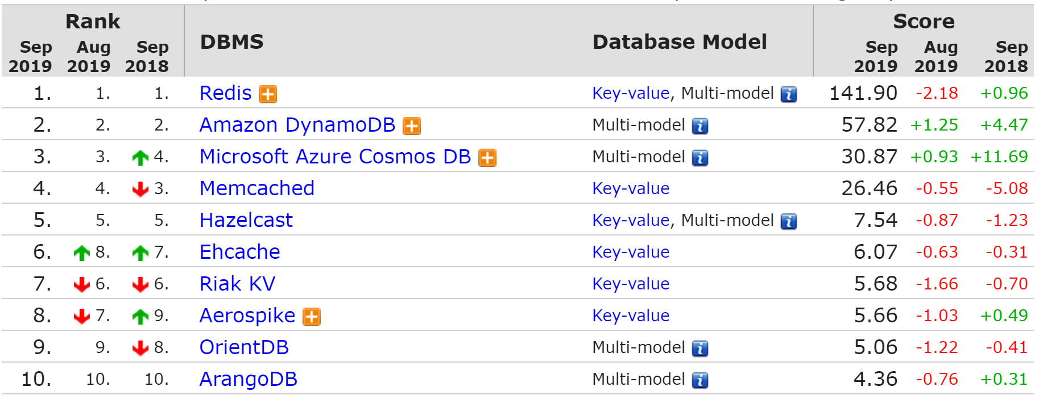
KEY-VALUE STORE RANK

Slide 23
REDIS
IN MEMORY (VERY FAST )
SUPPORTS TRANSACTION
EXPIRING KEY

Slide 24






REDIS IN CLOUD

Slide 25
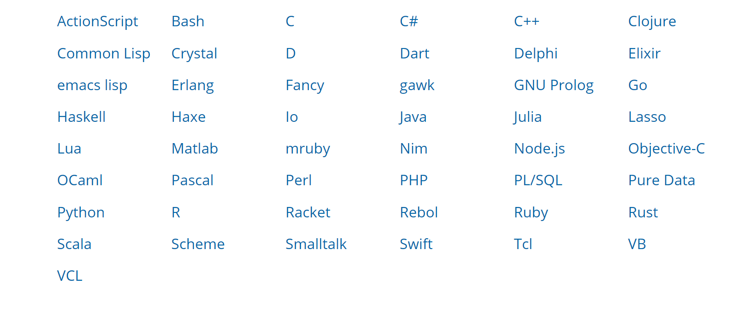
ACCESS REDIS

Slide 26
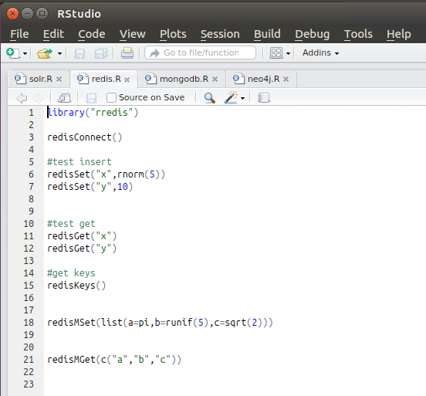
R STUDIO

Slide 27

REDIS PRACTICE WITH ZEPPELIN NOTEBOOK

Slide 28

SUITABLE USE CASES
USER PROFILE FOR
UI
USER PROFILE
TAG
SEARCH ENGINE
AS OF 2013 PINTEREST HAD 8000+ REDIS SHARDS ON AMAZON CLOUD

Slide 29
SUITABLE USE CASES
MESSAGING
PROCESSOR
DB
SOURCE
QUEUE
PROCESSOR
QUEUE DB

Slide 30
SUITABLE USE CASES
RESPONSE CACHE
DW
SELECT ITEM FROM SALES WHERE COUNTRY=‘HU’
REPORT
Sales ID | Country | Item
1 | HU | Chair
2 | HU | Flower
3 | HU | Space ship
4 | HU | Oracle DB

Slide 31
SUITABLE USE CASES
RESPONSE CACHE
DW
REPORT
CACHE
KEY: QUERY
VALUE: RESULT

Slide 32
USAGE
DO NOT USE WHEN YOU …
HAVE TO QUERY FOR RELATIONSHIPS
HAVE TO QUERY FOR HIERARCHY
HAVE TO QUERY BY MULTIPLE DIMENSIONS
WHEN YOU CANNOT CREATE A DISTINCT KEYS

Slide 33
NOSQL CLASSIFICATION
KEY-VALUE STORES
TIME SERIES DBMS
DOCUMENT STORES
COLUMN STORES
SEARCH ENGINES
GRAPH DBMS

Slide 34
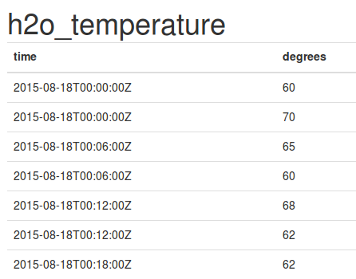
TIME SERIES DBMS
KEY: TIME
VALUE: TIME SERIES DATA (MEASUREMENT, EVENT ETC)

Slide 35
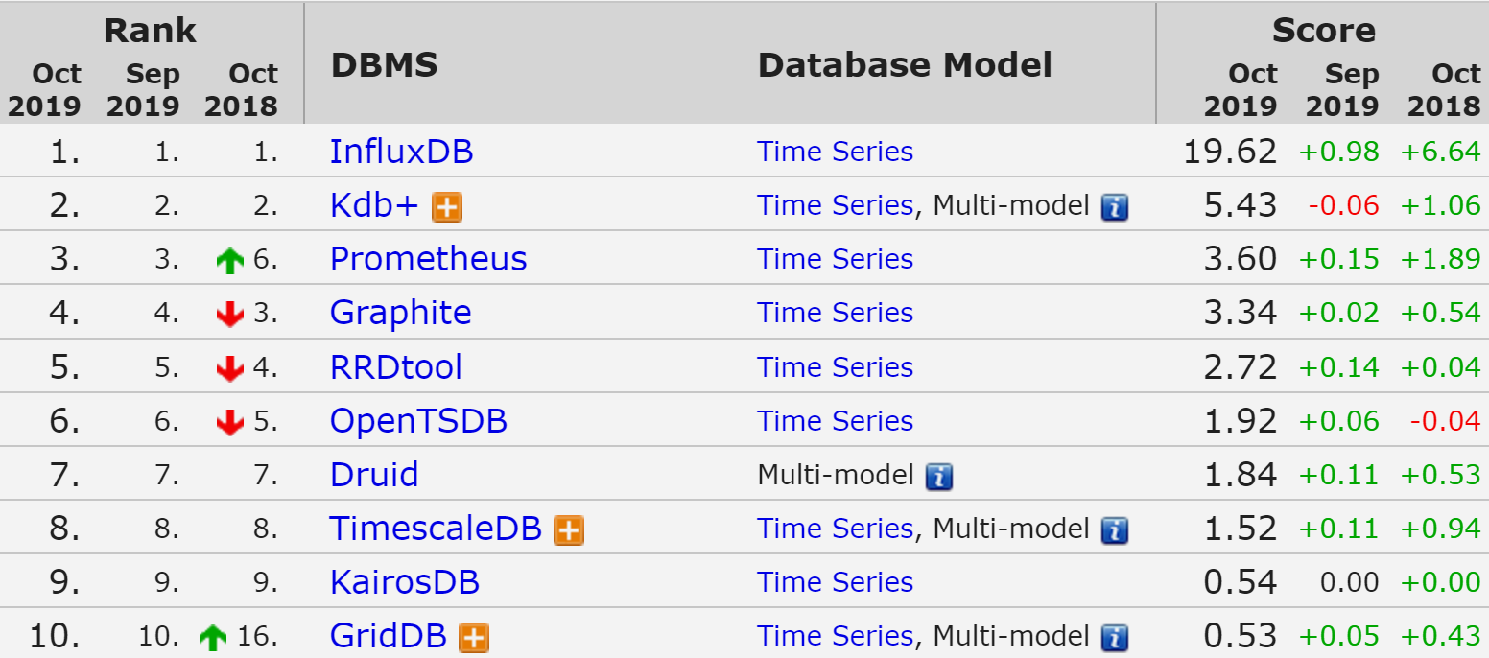
TIME SERIES DBMS

Slide 36
TIME SERIES DBMS - FEATURES
QUERY BY TIME
HIGH PERFORMING WRITE
STATISTICAL OPERATION ON TIME SERIES

Slide 37
INFLUX DB FUNCTIONS
Aggregations | Selectors | Transformations | Predictors | Technical Analysis
COUNT() | BOTTOM() | ABS() | HOLT_WINTERS() | CHANDE_MOMENTUM_OSCILLATOR()
DISTINCT() | FIRST() | ACOS() |  | EXPONENTIAL_MOVING_AVERAGE()
INTEGRAL() | LAST() | ASIN() |  | DOUBLE_EXPONENTIAL_MOVING_AVERAGE()
MEAN() | MAX() | ATAN() |  | KAUFMANS_EFFICIENCY_RATIO()
MEDIAN() | MIN() | ATAN2() |  | KAUFMANS_ADAPTIVE_MOVING_AVERAGE()
MODE() | PERCENTILE() | CEIL() |  | TRIPLE_EXPONENTIAL_MOVING_AVERAGE()
SPREAD() | SAMPLE() | COS() |  | TRIPLE_EXPONENTIAL_DERIVATIVE()
STDDEV() | TOP() | CUMULATIVE_SUM() |  | RELATIVE_STRENGTH_INDEX()
SUM() |  | DERIVATIVE()
 |  | DIFFERENCE()
 |  | ELAPSED()
 |  | EXP()
 |  | FLOOR()
 |  | HISTOGRAM()
 |  | LN()
 |  | LOG()
 |  | LOG2()
 |  | LOG10()
 |  | MOVING_AVERAGE()
 |  | NON_NEGATIVE_DERIVATIVE()
 |  | NON_NEGATIVE_DIFFERENCE()
 |  | POW()
 |  | ROUND()
 |  | SIN()
 |  | SQRT()
 |  | TAN()

Slide 38
INFLUX
DOWNSAMPLING AND DATA RETENTION
SQL LIKE QUERIES
ECOSYSTEM FOR ACQUISITION,
STORAGE,
PROCESSING,
AND VISUALIZATION

Slide 39
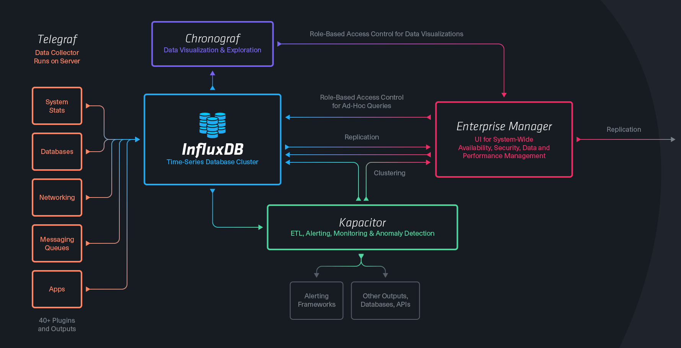
INFLUX TICK STACK

Slide 40
TERMINOLOGY
SQL SERVER | INFLUX
Database | Database
Table | Measurement
Index | Index
Row | Point
Column | Field,Tag
Joining | Join
Partition | Sharding

Slide 41

INFLUXDB PRACTICE

Slide 42

USE CASE EXAMPLE
VISUALIZE
IoT
Metrics Influx
(Aggregate)
PROCESSOR
SENSORS
Event Influx
(Interpret)
QUEUE
PROCESSOR
KEY VALUE
MONITOR

Slide 43
USAGE
TIME SERIES DATA FLUX WHICH YOU WANT TO
VISUALIZE TRANSFORM / AGGREGATE
DO REAL TIME ANALYTICS

Slide 44
USE CASES
IOT
SYSTEM / INFRASTRUCTURE MONITORING
SMART CITY
INDUSTRY 4.0
ANOMALY DETECTION
TRADING DATA

Slide 45
USAGE
DO NOT USE WHEN YOU …
DON’T HAVE TIME SERIES DATA FLUX
NEED TRANSACTION

Slide 46
NOSQL CLASSIFICATION
KEY-VALUE STORES
TIME SERIES DBMS
DOCUMENT STORES
COLUMN STORES
SEARCH ENGINES
GRAPH DBMS

Slide 47
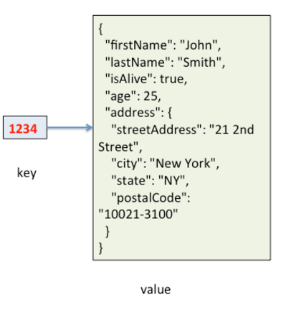
DOCUMENT STORES
KEY: ID
VALUE: QUERYABLE STRUCTURED DOCUMENT

Slide 48
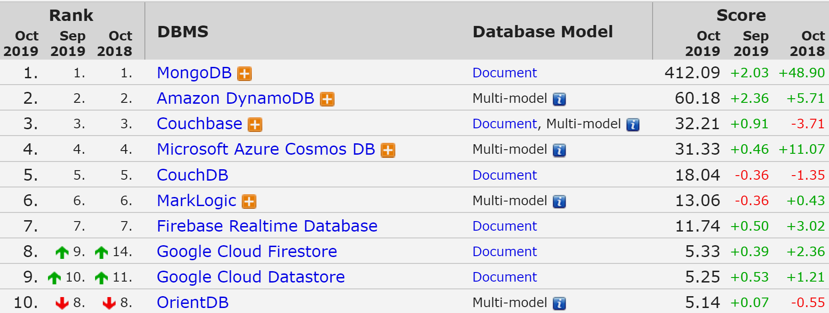
DOCUMENT STORES

Slide 49
MONGODB
THE MOST USED NOSQL
CLOSER TO GENERAL PURPOSE / SLOWER
HIGH AVAILABILITY / AUTOMATIC FAILOVER
HIGHLY SCALABLE / REBALANCING
SELECTABLE CONSISTENCY
NO TRANSACTION SUPPORT
DYNAMIC SCHEMA

Slide 50
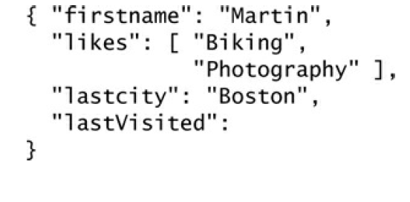
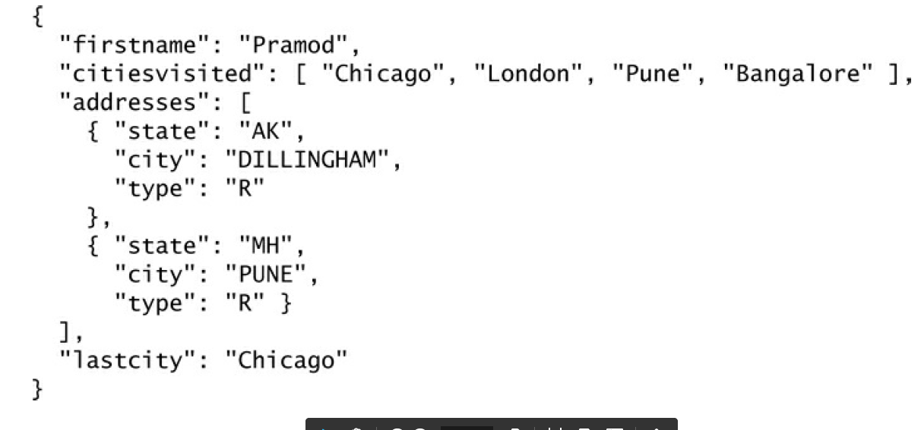
DYNAMIC SCHEMA
BE CAREFUL!

Slide 51
TERMINOLOGY
SQL SERVER | MONGODB
Database | Database
Table | Collection
Index | Index
Row | Document
Column | Field
Joining | Linking & Embedding
Partition | Sharding

Slide 52




MONGO ACCESS
BI TOOLS
PROGRAMING LANGUAGES

Slide 53

MONGO PRACTICE

Slide 54
USAGE
WHEN YOU WANT TO STORE/QUERY HIGH VOLUME OF MULTIDIMENSIONAL DATA
AND
FAILOVER, HIGH AVAILABILITY AND CONSISTENCY MATTERS FOR YOU

Slide 55



USES CASES
https://www.mongodb.com/industries/

Slide 56
WHEN NOT TO USE
DO NOT USE WHEN
MONGO CAN’T HANDLE YOUR DATA SIZE
YOU NEED TRANSACTIONS
YOU NEED COMPLEX AGGREGATIONS
YOU HAVE COMPLEX RELATIONS

Slide 57
NOSQL CLASSIFICATION
KEY-VALUE STORES
TIME SERIES DBMS
DOCUMENT STORES
COLUMN STORES
SEARCH ENGINES
GRAPH DBMS

Slide 58
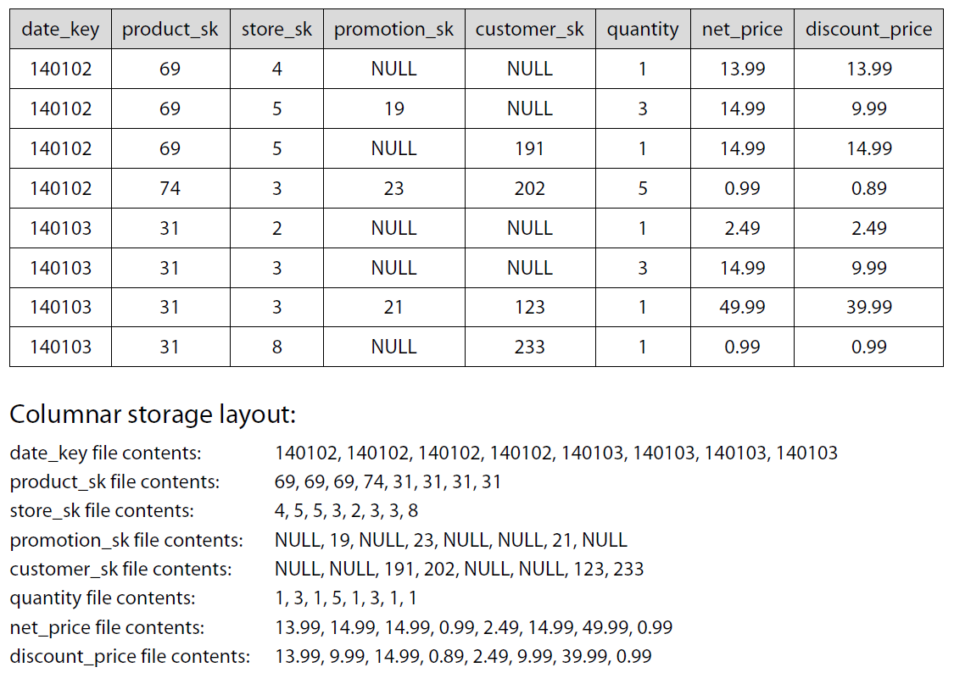
CLASSICAL DATA TABLE
140102 69 4 NULL NULL 1 13.99 13.99 140102 69 5 19 NULL 3 14.99 9.99 140102 69 5 NULL 191 1 14.99 14.99 140102 74 3 23 202 5 0.99 0.89 140103 31 2 NULL NULL 1 2.49 2.49 140103 31 3 NULL NULL 3 14.99 9.99 140103 31 3 21 123 1 49.99 39.99 140103 31 8 NULL 233 1 0.99 0.99
DISCOUNT PRICES FOR LAST DAY ?

Slide 59
WIDE COLUMN STORES

Slide 60
COMPARE DISK ACCESS
CLASSICAL TABULAR DATA
140102 69 4 NULL NULL 1 13.99 13.99 140102 69 5 19 NULL 3 14.99 9.99 140102 69 5 NULL 191 1 14.99 14.99 140102 74 3 23 202 5 0.99 0.89 140103 31 2 NULL NULL 1 2.49 2.49 140103 31 3 NULL NULL 3 14.99 9.99 140103 31 3 21 123 1 49.99 39.99 140103 31 8 NULL 233 1 0.99 0.99
WIDE COLUMN STORES
140102 140102 140102 140102 140103 140103 140103 140103 69 69 69 74 31 31 31 31 4 5 5 3 2 3 3 8 NULL 19 NULL 23 NULL NULL 21 NULL NULL NULL 191 202 NULL NULL 123 233 1 3 1 5 1 3 1 1 13.99 14.99 14.99 0.99 2.49 14.99 49.99 0.99 13.99 9.99 14.99 0.89 2.49 9.99 39.99 0.99

Slide 61
COMPRESSION
CLASSICAL TABULAR DATA
140102 69 4 NULL NULL 1 13.99 13.99 140102 69 5 19 NULL 3 14.99 9.99 140102 69 5 NULL 191 1 14.99 14.99 140102 74 3 23 202 5 0.99 0.89 140103 31 2 NULL NULL 1 2.49 2.49 140103 31 3 NULL NULL 1 14.99 9.99 140103 31 3 21 123 1 49.99 39.99 140103 31 8 NULL 233 1 0.99 0.99
WIDE COLUMN STORES
140102 140102 140102 140102 140103 140103 140103 140103 69 69 69 74 31 31 31 31 4 5 5 3 2 3 3 8 NULL 19 NULL 23 NULL NULL 21 NULL NULL NULL 191 202 NULL NULL 123 233 1 3 1 5 1 1 1 1 13.99 14.99 14.99 0.99 2.49 14.99 49.99 0.99 13.99 9.99 14.99 0.89 2.49 9.99 39.99 0.99

Slide 62
KEY FEAUTRES
FASTER ACCESS TIME WHEN YOU QUERY A FEW NEED DIMENSIONS
READ OPTIMIZED
HIGHLY SCALABLE BY DIMENSION
COMPRESSION
NEW GENERATION OF DW

Slide 63
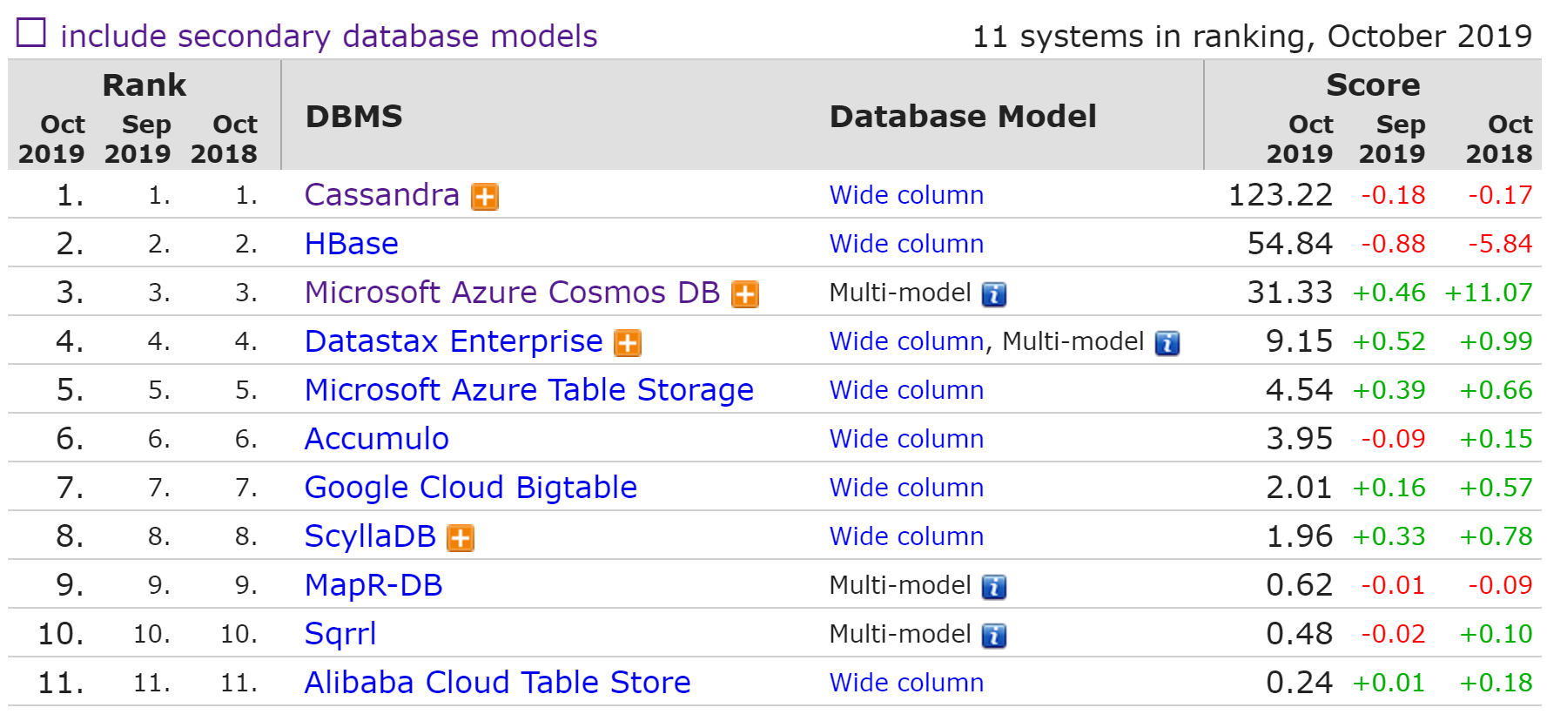
WIDE COLUMN STORE RANK

Slide 64

USE CASE – GOOGLE ANALYTICS

Slide 65
NOSQL CLASSIFICATION
KEY-VALUE STORES
TIME SERIES DBMS
DOCUMENT STORES
COLUMN STORES
SEARCH ENGINES
GRAPH DBMS

Slide 66



MANY BUILT-IN FUNCTIONS
Facet search
Text Analysis
Geospatial Search
+ Build your own

Slide 67
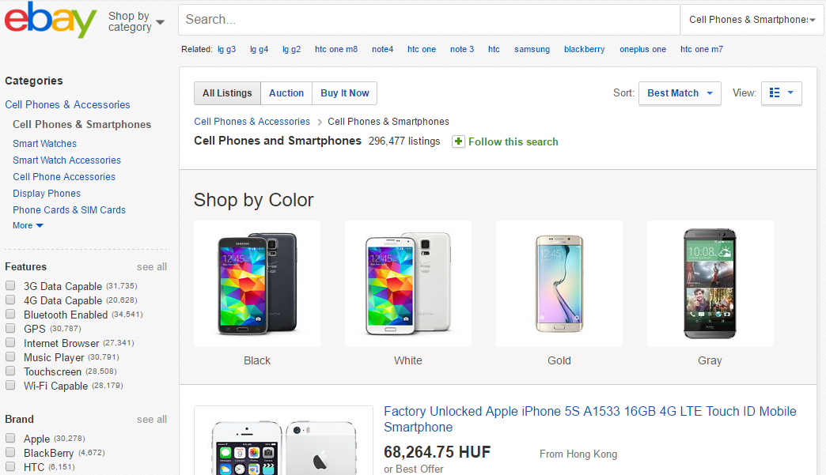
FACETED SEARCH

Slide 68
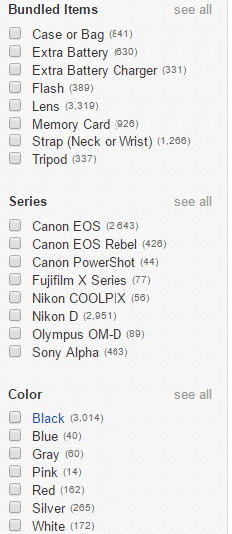
FACETED SEARCH
GUIDED QUERIES
E-COMMERCE: GUIDE YOUR CUSTOMERS
ANALYTICS: SLICING AND DICING, SELF SERVICE BI

Slide 69
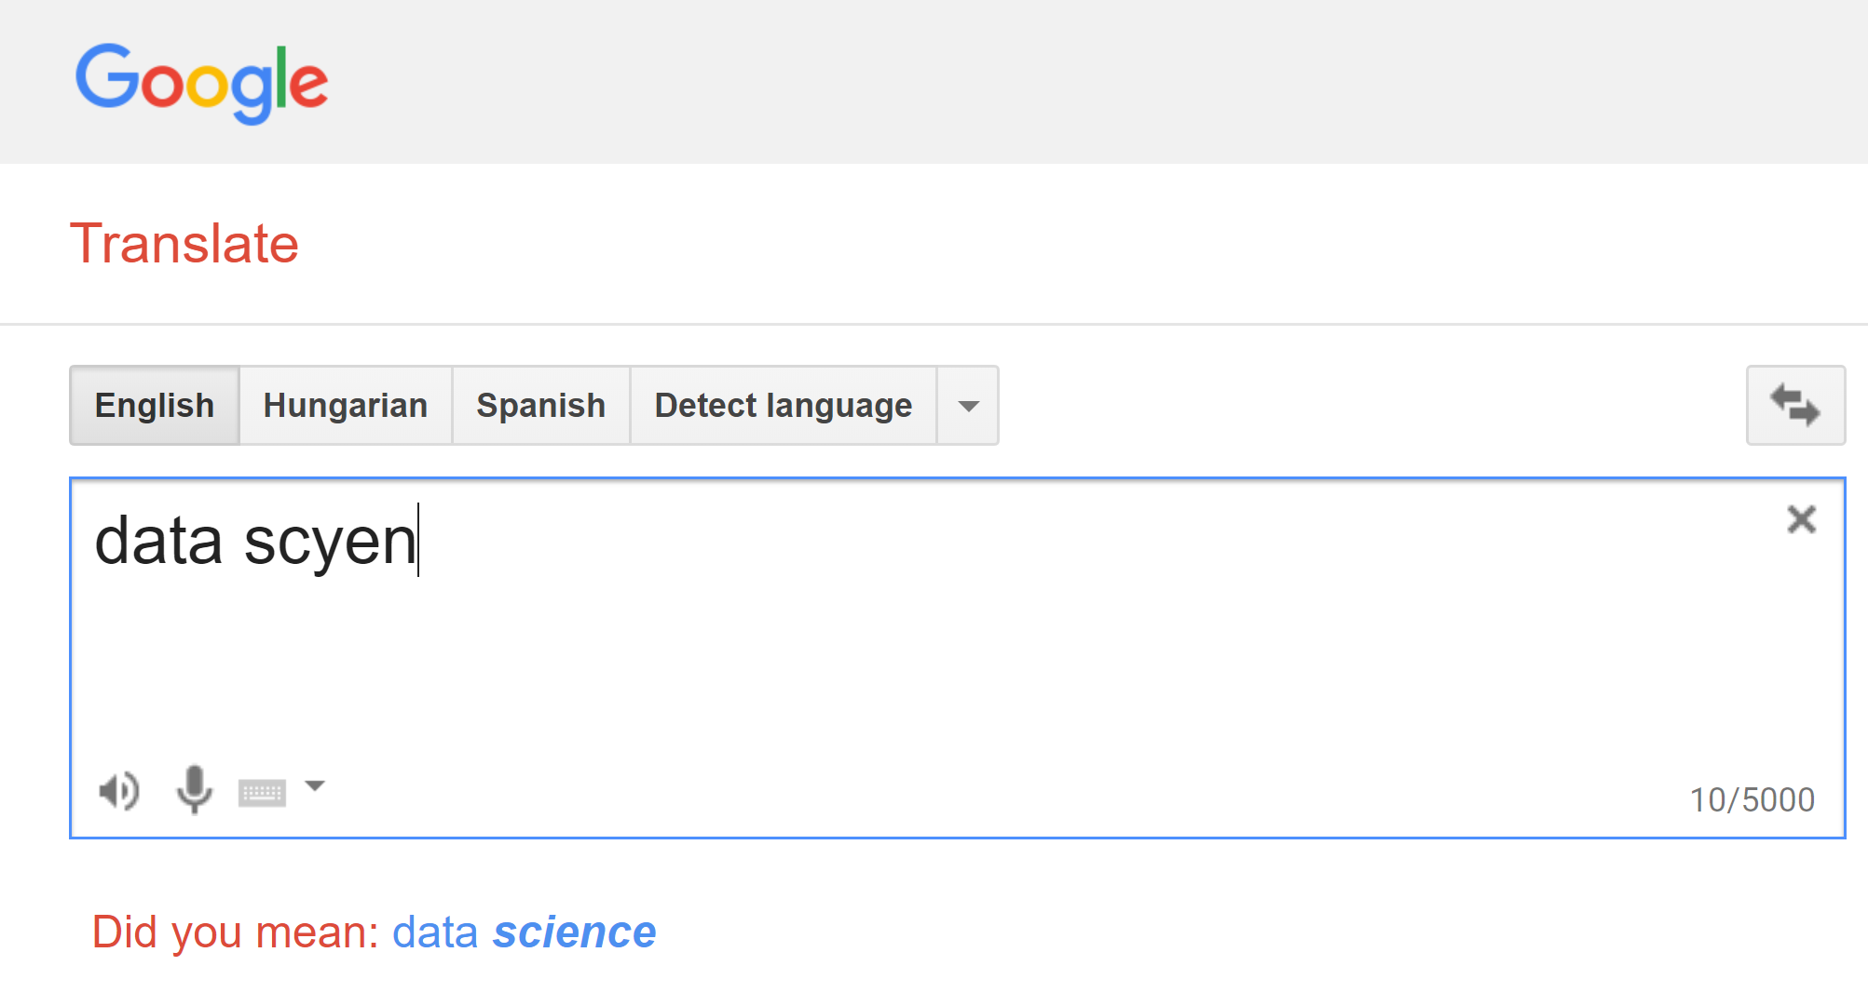
TEXT FUNCTIONS

Slide 70
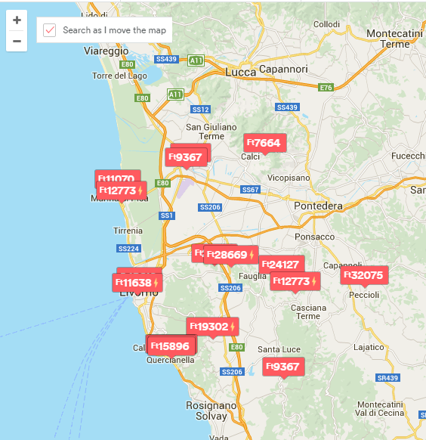
GEOSPATIAL SEARCH
COORDINATES TO EACH RECORD
QUERY:
AREA BY DIFFERENT SHAPES
PROXIMITY

Slide 71
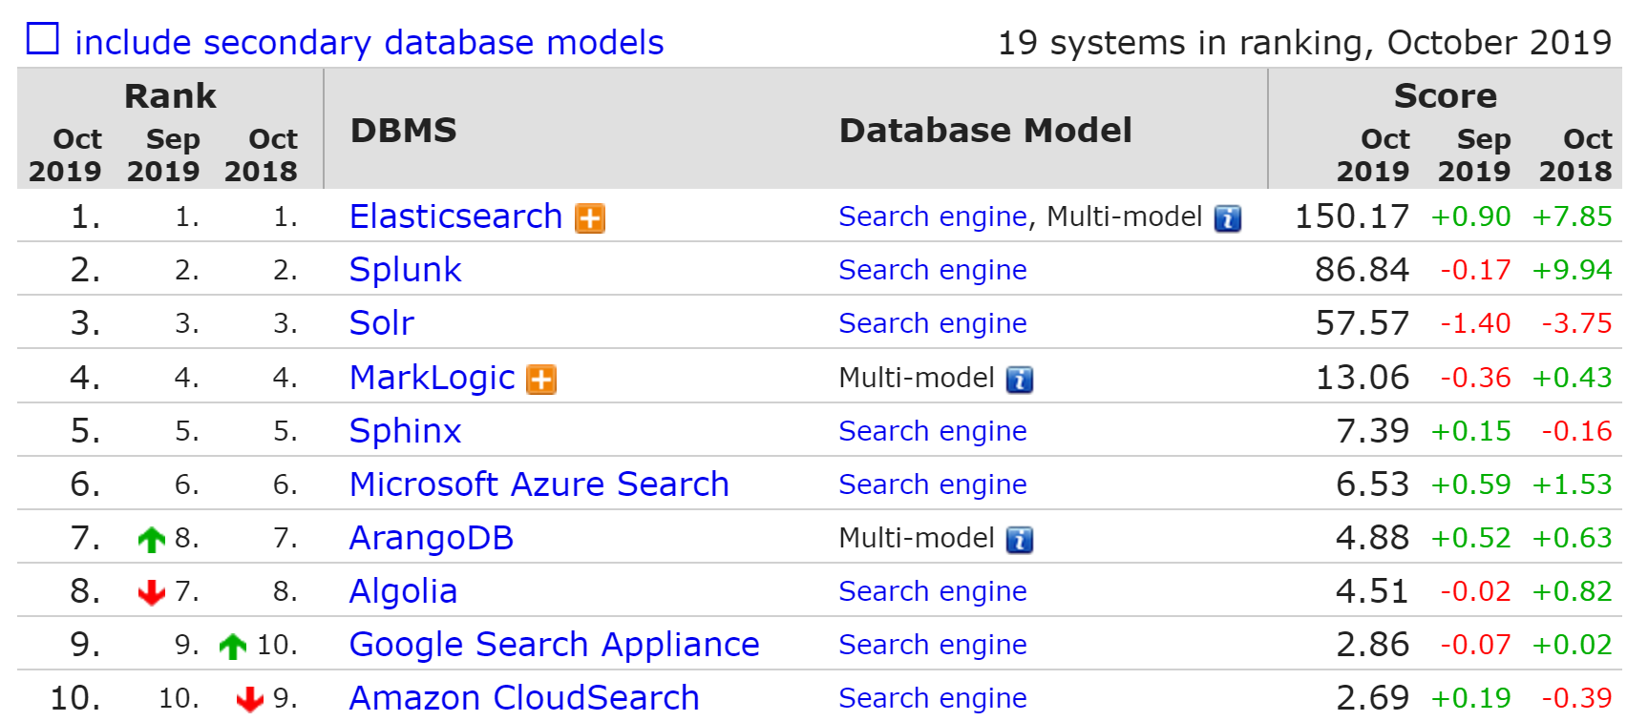
SEARCH ENGINES RANK

Slide 72

PRACTICE

Slide 73
WHEN TO USE SEARCH ENGINES
WHEN YOU NEED COMPLEX DOCUMENT QUERIES
E-COMMERCE (EBAY, EXPEDIA)
ANALYTICS (NETFLIX)
TEXT SEARCH (WIKIPEDIA)

Slide 74
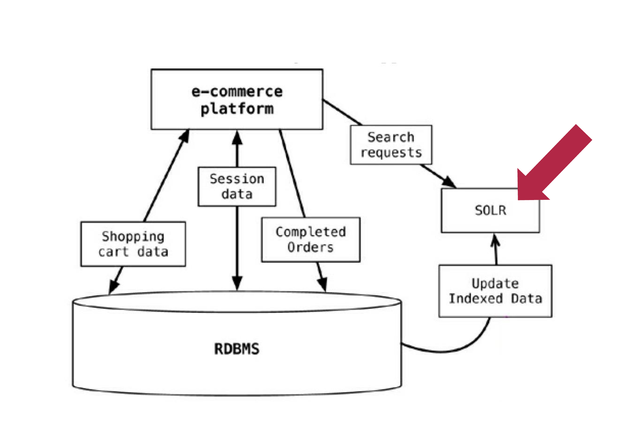
USECASE - ECOMMERCE

Slide 75
NOSQL CLASSIFICATION
KEY-VALUE STORES
TIME SERIES DBMS
DOCUMENT STORES
COLUMN STORES
SEARCH ENGINES
GRAPH DBMS

Slide 76
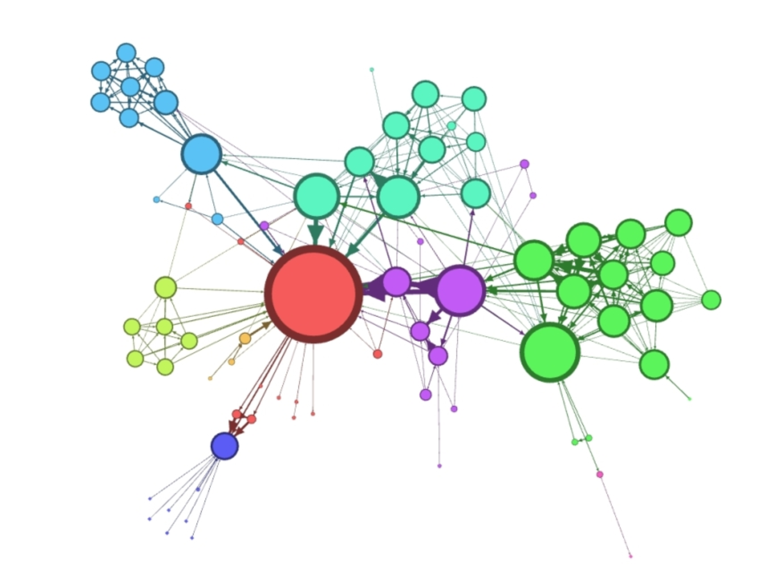
GRAPH DATA STRUCTURES

Slide 77

NETWORK SCIENCE
HOW KEVIN BACON CHANGED DATA SCIENCE ?

Slide 78

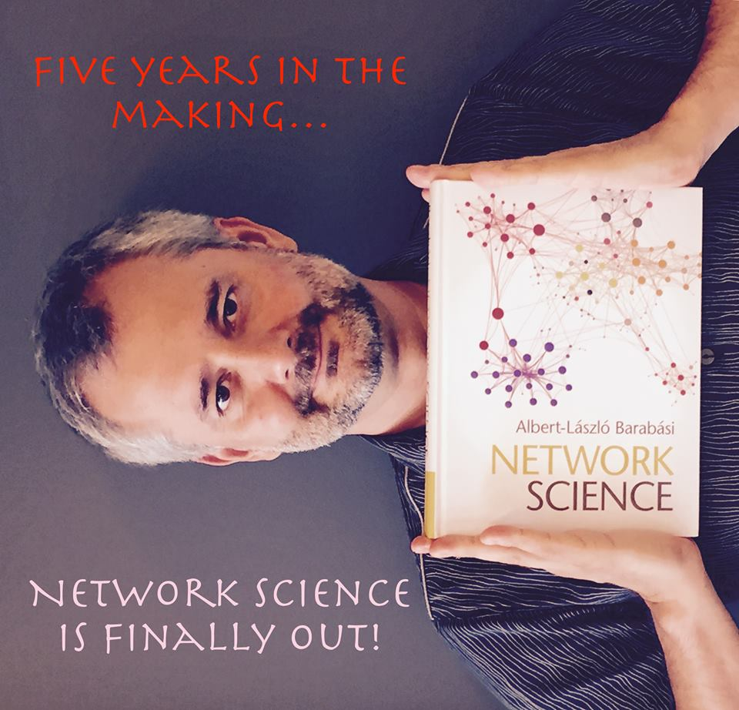
BOOKS

Slide 79
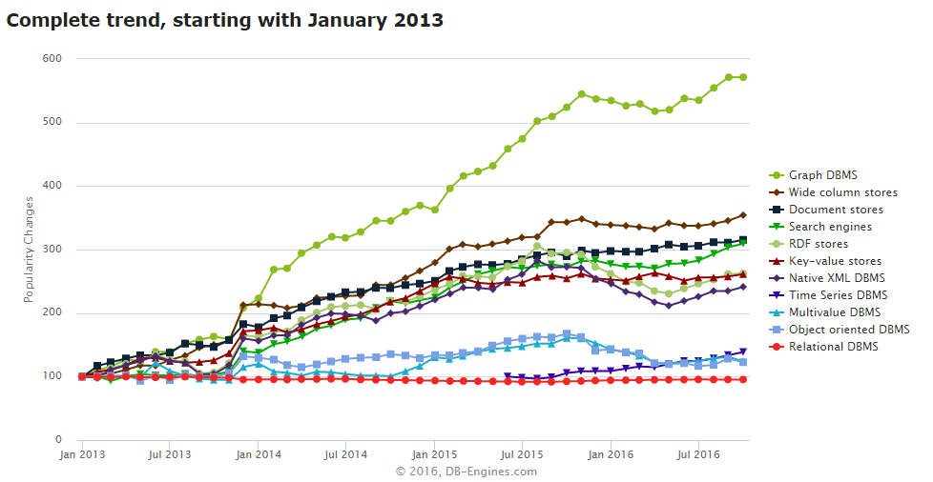
DATA SCIENCE
NEW
TYPE
ANALYTICS

Slide 80
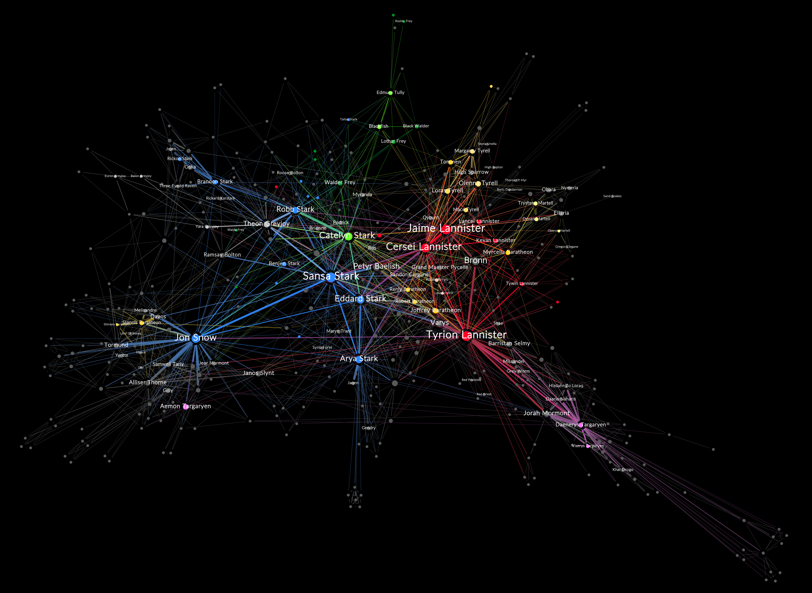
FEATURE ENGINEERING

Slide 81


ROBUSTNESS TESTING
Notes:
INSTEAD OF EXPLORING EMPIRICALLY

Slide 82
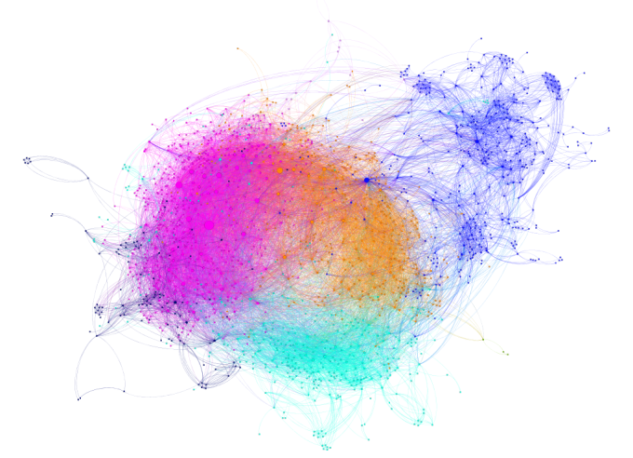
SEGMENTATION / FRAUD DETECTION

Slide 83
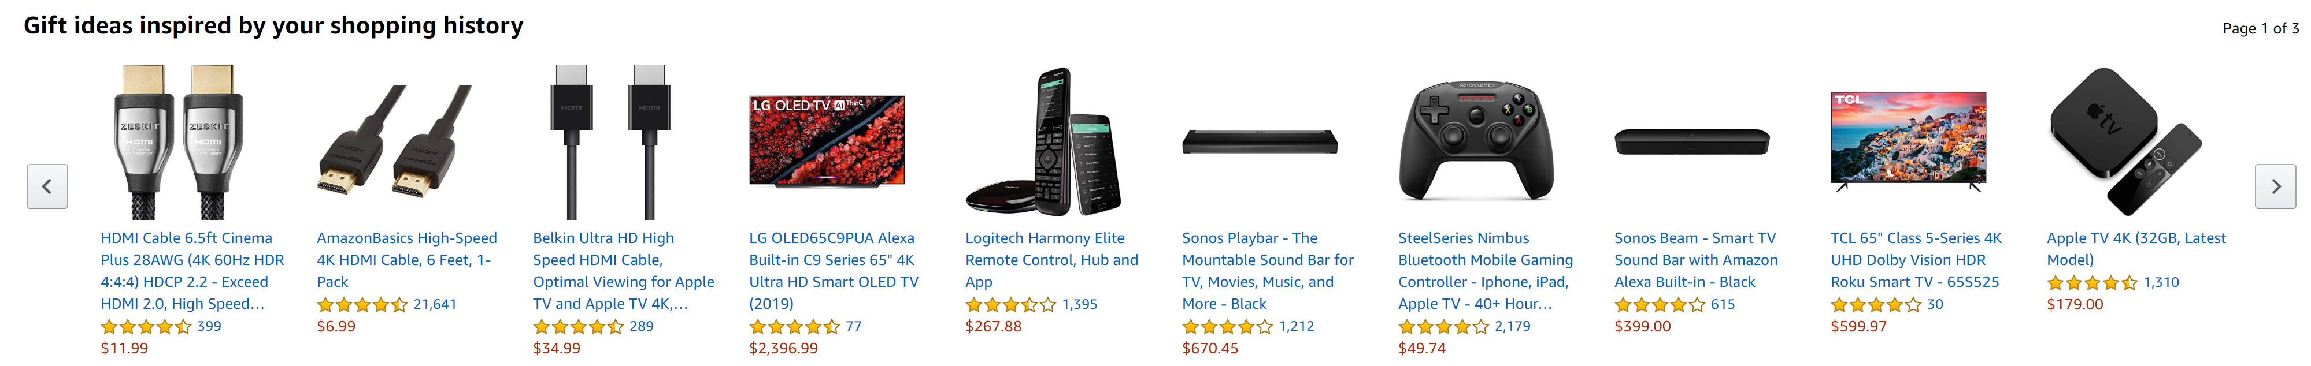
RECOMMENDATION ENGINE

Slide 84
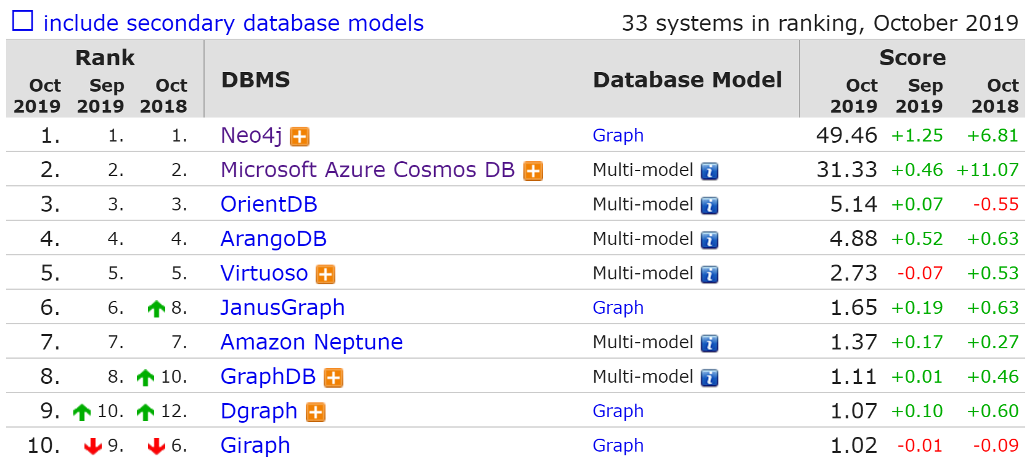
GRAPH DBMS RANK

Slide 85

PRACTICE

Slide 86
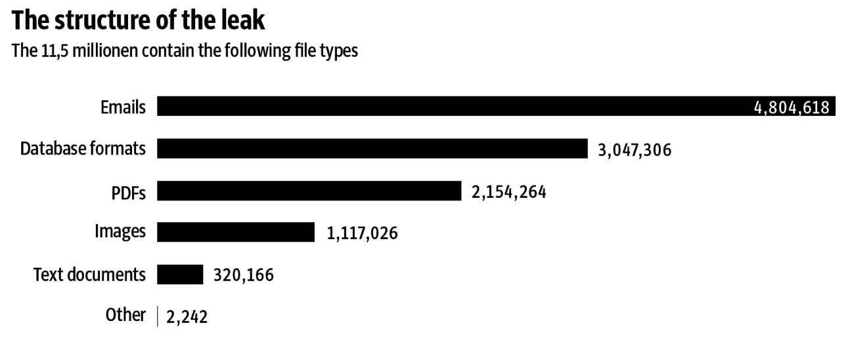
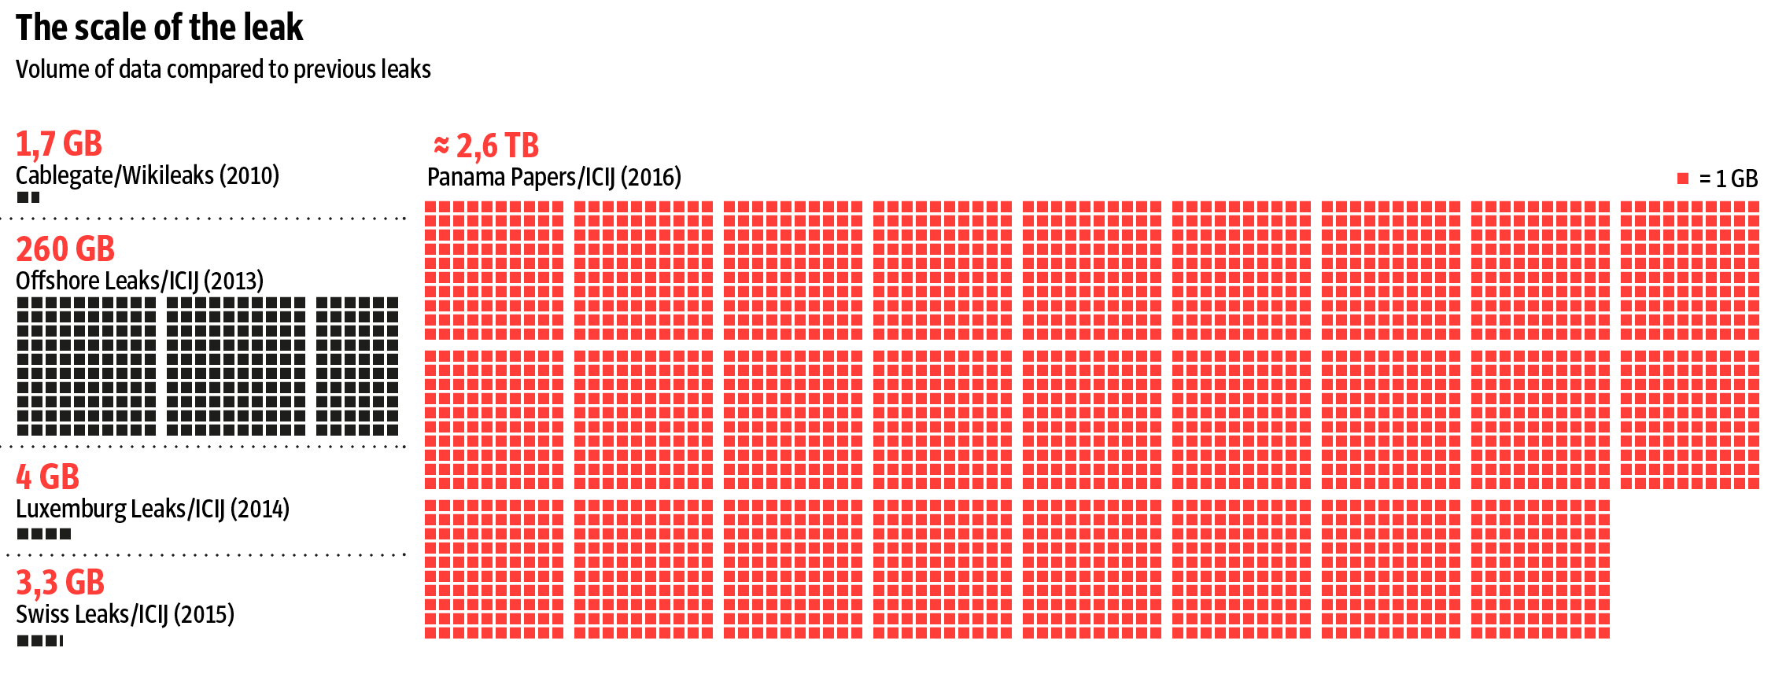
PANAMA PAPERS

Slide 87
PANAMA PAPERS – CLASSICAL FLOW
SCAN
OCR
DIGITAL TEXT
ETL
STRUCTURED DATA
RDBMS
SQL API
ANALYTICS
SOME STRUCTURED DATA
DATA MINING

Slide 88
WITH SEARCH ENGINE
Rich Document Parsing or NLP
Text Analysis
SCAN
SOLR +TIKA
DATA INGESTION
DATA INGESTION
DATA INGESTION
ANALYTICS
SEARCH ALGORITHM
SEARCH ALGORITHM
SEARCH ALGORITHM

Slide 89
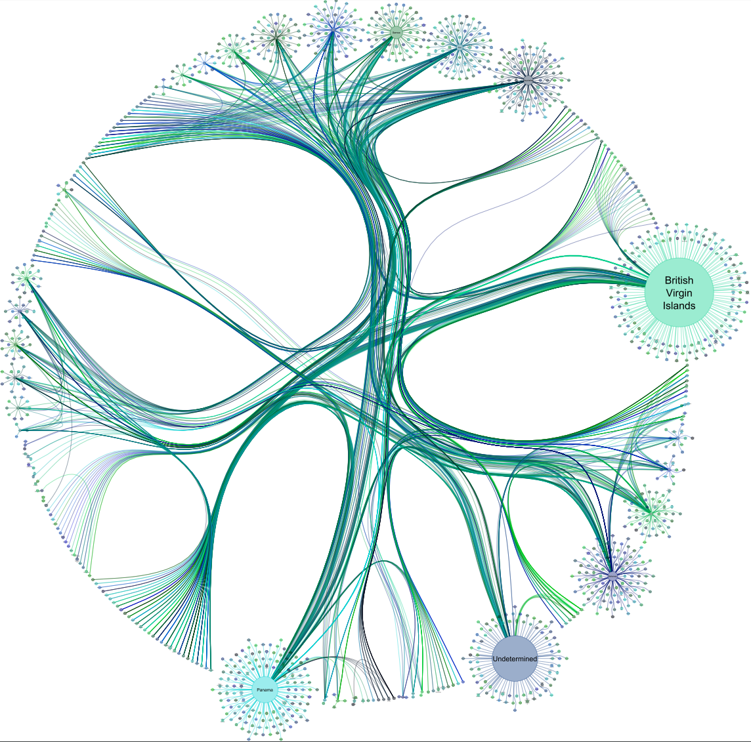

ADVANCED ANALYTICS
NEO4J
SOLR +TIKA
DATA INGESTION
DATA INGESTION
DATA INGESTION
ML
MODEL
SEARCH ALGORITHM
SEARCH ALGORITHM
SEARCH ALGORITHM

Slide 90
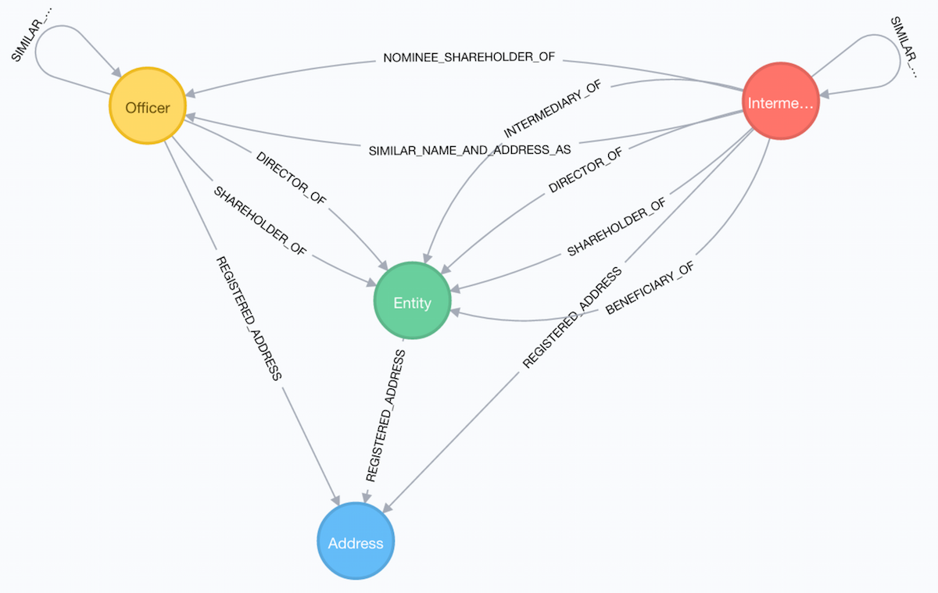
PANAMA PAPERS SCHEMA
Entity - The offshore legal entity. This could be a company, trust, foundation …
Officer - A person or company who plays a role in an offshore entity, such as beneficiary, director, or shareholder.
Intermediary - A go-between for someone seeking an offshore corporation and an offshore service provider — usually a law-firm or a middleman that asks an offshore service provider to create an offshore firm.
Address - The registered address

